Slide 1
Dog Psychologists Intranet Site
Team Name undefined

Slide 2
Introduction of Project
Intranet Site
Events
Employees

Slide 3
Deliverables
Home page
Employee of the Week
Next upcoming event
Display Employees
Search by name, role
HR access can Add, Edit, Remove Employee
Display Upcoming Events
Search by event name, date, category
Event committee can Add, Edit, Remove Event
Stretch Goal: Calendar of Events

Slide 4
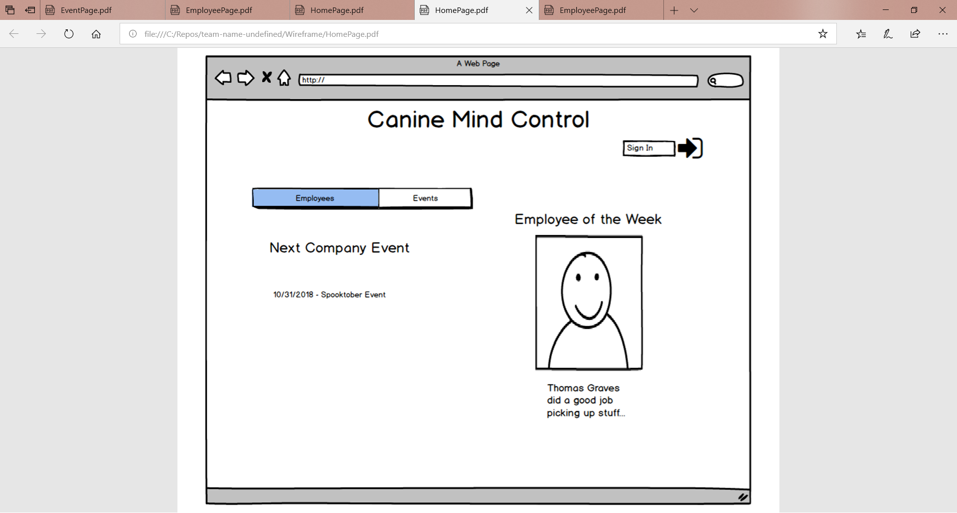

Slide 5
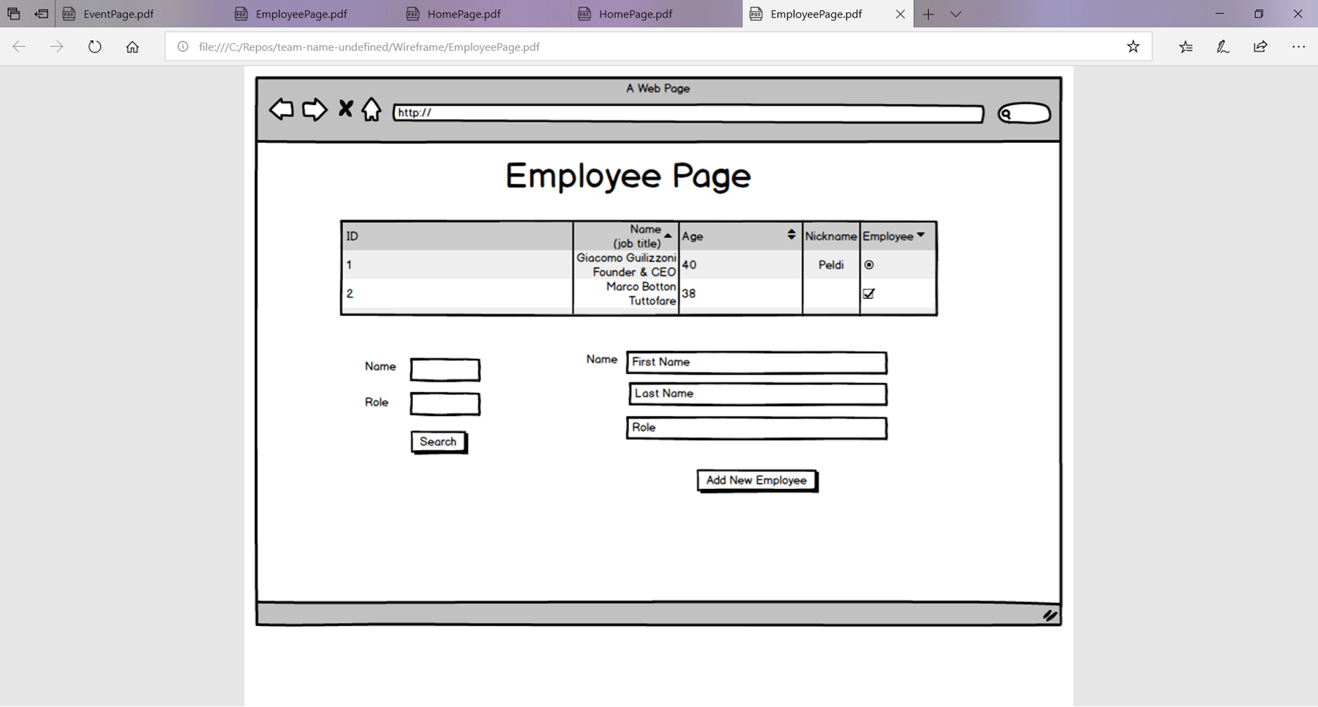

Slide 6
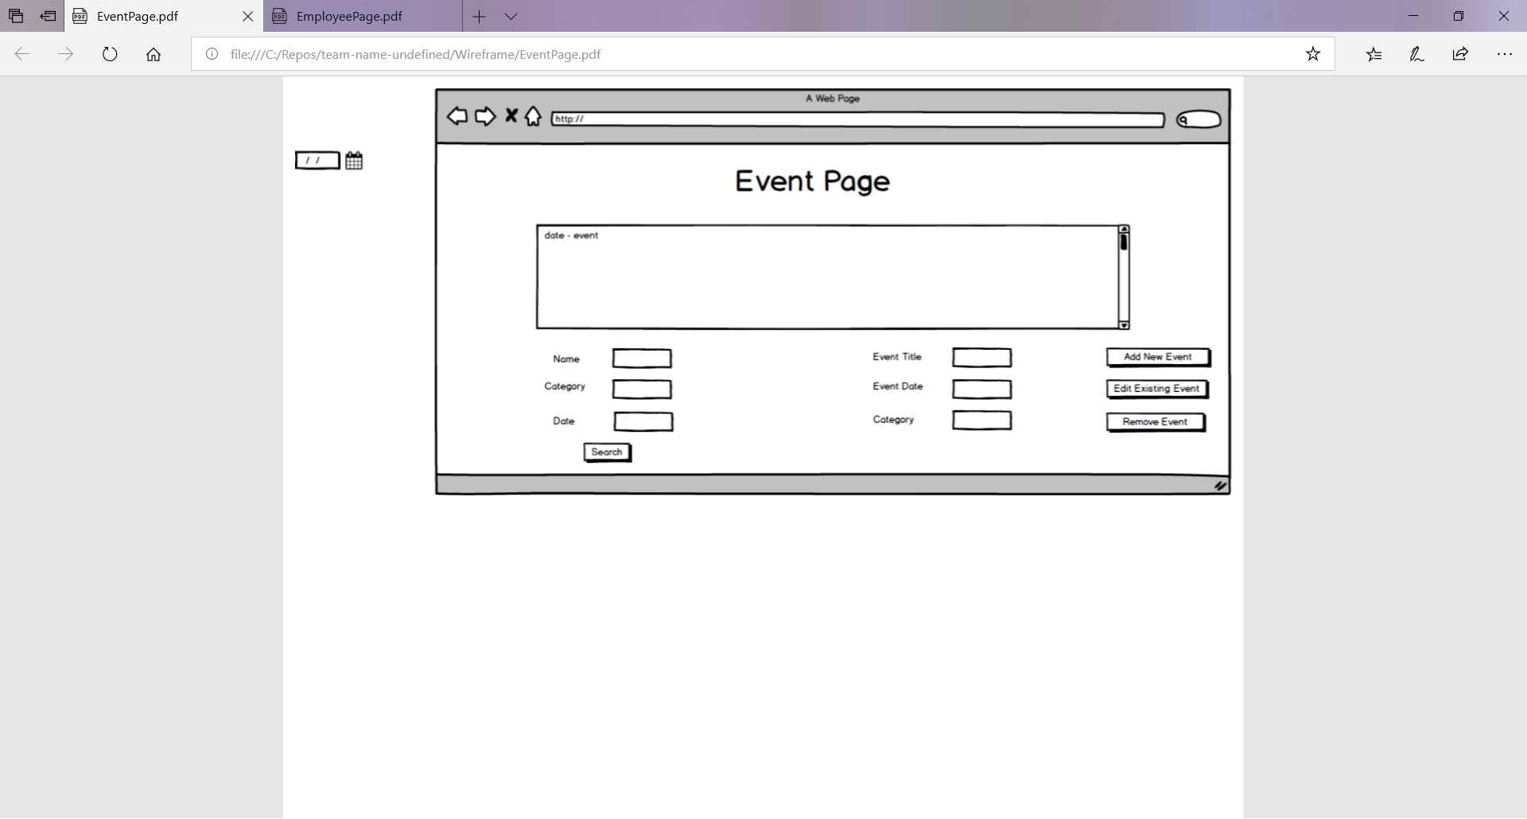

Slide 7
Further Clarification
Requirements of Employee of the Week
Requirements of Employee Data
Requirements of Role
Goals for Events

Slide 8
Questions or Concerns
Feedback
Any questions
Thank You!

